Slide 1
Facial image recognition with convolutional neural networks
Final capstone by tim Copeland

Slide 2
Applications of Facial Recognition Technology
Security
Authentication (FaceID)
Autotagging (Facebook, Instagram, etc.)

Slide 3
Goal
Develop algorithm capable of identifying people based on faces
Develop software that locates and identifies people in an uncropped picture

Slide 4
Intermediate Goal: Gender/attribute prediction
Likely an easier problem to solve
Will provide proof of efficacy of NN’s in solving facial recognition problems

Slide 5
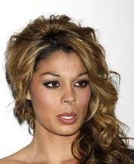
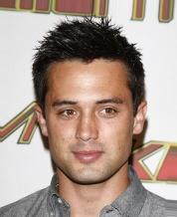
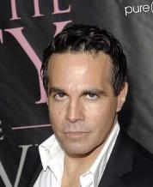
Data set: celebA
Over 200,000 images of about 10,000 celebrities
40 attributes like gender, whether the subject is smiling, or wearing makeup or glasses

Slide 6
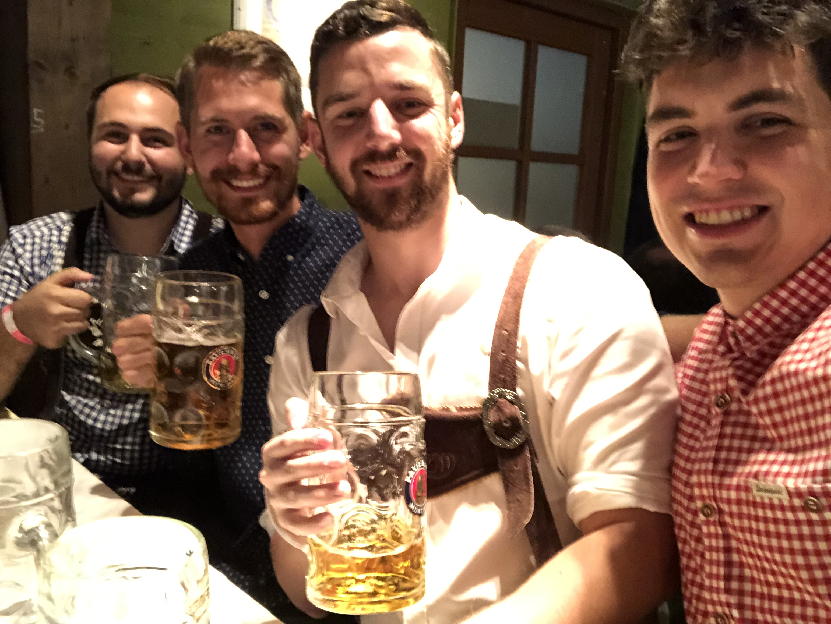
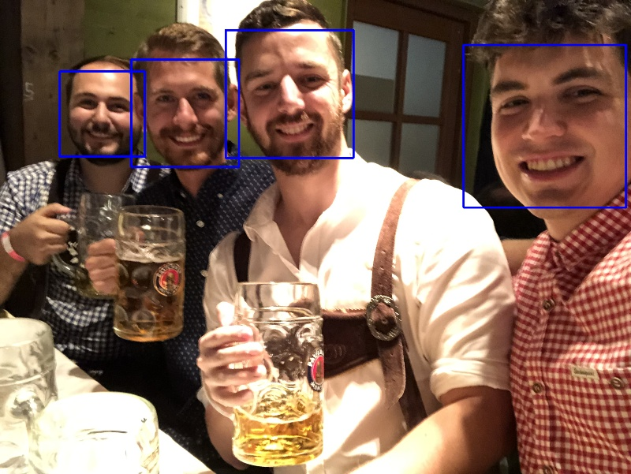
Part 1: Identifying/cropping faces

Slide 7
Haas cascade classifier
Included in the OpenCV library
Reduces complexity/dimensionality to make identifying objects less computationally expensive
Creates feature set based on pixel intensities in rectangular regions, and corresponding differences between adjacent regions

Slide 8
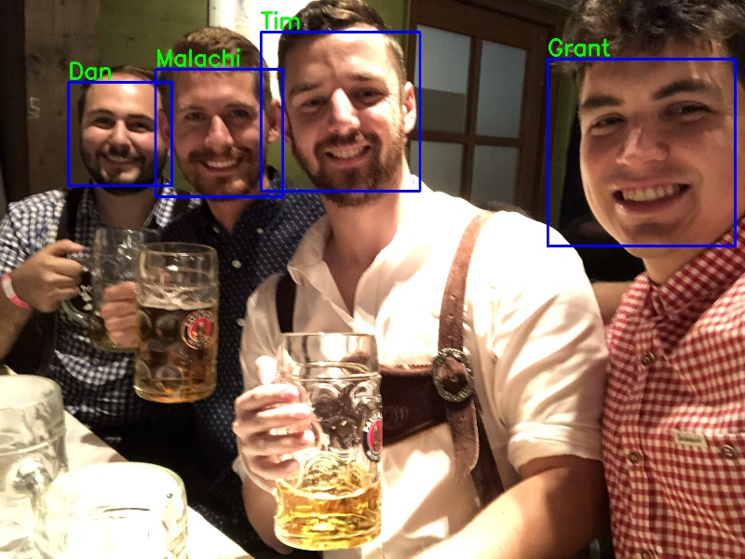
Part 2: Predicting identities

Slide 9
Models tested
Multi-layer Perception Model
Convolutional Neural Networks
Levi-Hassner CNN (from a 2015 paper found here)

Slide 10
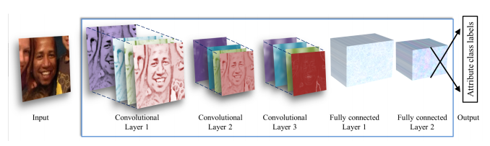
Levi-hassner Model

Slide 11
Results – Attribute Prediction
 | Baseline | Uncropped faces | Cropped faces
Gender - Simple CNN | 58% | 90.5% | 91.8%
Gender - Levi-Hassner | 58% | 91.4% | 95.6%
Age - Simple CNN | 77% | N/A | 84.4%
Age - Levi-Hassner | 77% | N/A | 83.7
Makeup - Simple CNN | 61% | N/A | 87.8%
Makeup - Levi-Hassner | 61% | N/A | 88.9%

Slide 12
Results – ID prediction (500 unique ids)
 | Baseline | Uncropped faces | Cropped faces
Simple CNN | 0.2% | 24.4% | 23.4%
Levi-Hassner | 0.2% | 47.2% | 47.7%

Slide 13
Results – Id prediction (10 unique ids)
 | Baseline | Uncropped faces | Cropped faces
Simple CNN | 10% | N/A | 80%
Levi-Hassner | 10% | N/A | 83%

Slide 14
Part 2 – Facial recognition in “real” pictures
Collected 197 pictures of friends and family
Identified ~900 faces, manually sorted into 10 people of interest
Trained model with dataset of about 300 cropped face images

Slide 15
Training the model
Able to train several models to achieve 90% accuracy on a test data set
Some models generalized well, others (even high-scoring ones) did not

Slide 16
Writing the program
Use OpenCV library to open image as Numpy Array
Apply Cascade Classifier (also in OpenCV) to identify faces
Feed face into trained model to identify people in the picture
Display picture with identified faces and print predicted identities

Slide 17
Takeaways
“Homemade,” neural network models can do reasonably well at identifying faces, even with a small training data set, as long as the number of unique identities is small enough
Companies like Facebook, whose product entails a massive dataset of tagged pictures, have an incredible advantage in developing facial recognition technology
I would like to learn more about setting parameters and choosing which set of weights one would choose to use in a production model

Slide 18
Extensions
Obviously – improve model accuracy
Not sure what the upper bound is with limited sample size
Facial alignment
Feature creation
Implement model into photo viewing app
Look into FaceNet and other open-source libraries

